Slide 1
Exploring T-20 World Cup 2022 Data
May 5, 2024

Slide 2
Agenda
Exploring T-20 World Cup 2022 Data
Slide 2: Loading the Dataset
Data Exploration
In-Depth Analysis
Event Inference
Performance Evaluation
Performance Evaluation Continued
Statistical Insights

Slide 3
Exploring T-20 World Cup 2022 Data
Introduction
This presentation delves into the T-20 World Cup 2022 dataset using Python and the Pandas library. It aims to uncover insights and patterns, starting with data loading and exploration, moving on to in-depth analysis and event inference, evaluating player performances, and gaining statistical insights. The use of Python and Pandas library is showcased as an effective method for exploring and deriving insights from sports datasets.

Slide 4
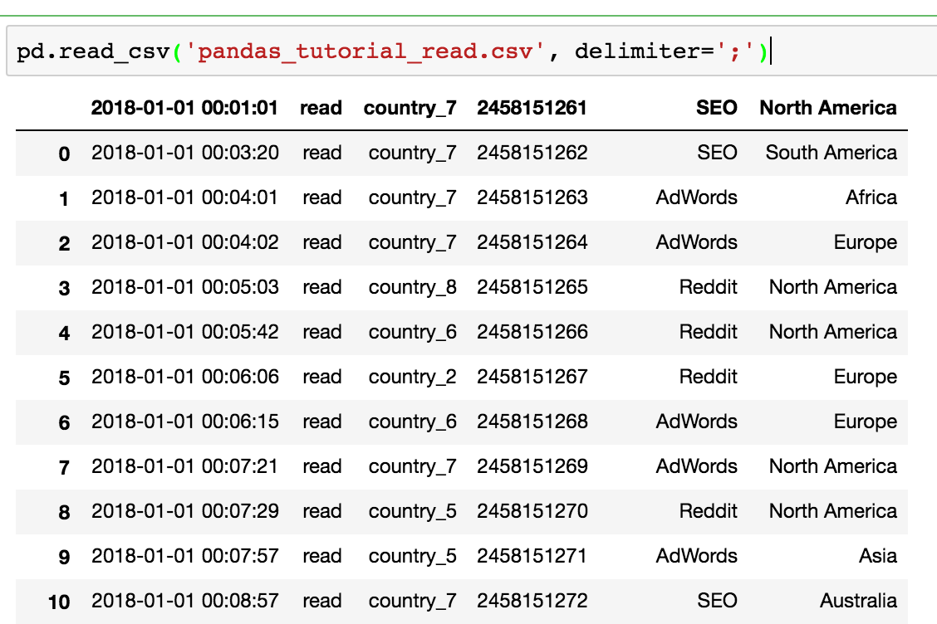
Slide 2: Loading the Dataset
Data Processing
Loading the Dataset
Import the Pandas library using 'import pandas as pd'.
Utilize the read_csv function to load the dataset, providing the file path.
The 'r' before the file path serves as a raw string literal, allowing the use of backslashes without escaping them.

Slide 5

Data Exploration
Exploration
Data Exploration
We start by exploring the dataset to understand its contents.
Print match details like match ID, home team, away team, innings ID, and runs scored.
Use of code snippets to demonstrate the extraction of match details from the dataset.

Slide 6

In-Depth Analysis
Analysis
In-Depth Analysis
We conduct an in-depth analysis by aggregating player statistics like total runs scored and total balls faced by each batsman.
This analysis provides a comprehensive overview of individual player performances and their contributions to the matches.
Using the groupby function, we aggregate player statistics and then use the print function to display a summary of the data.

Slide 7
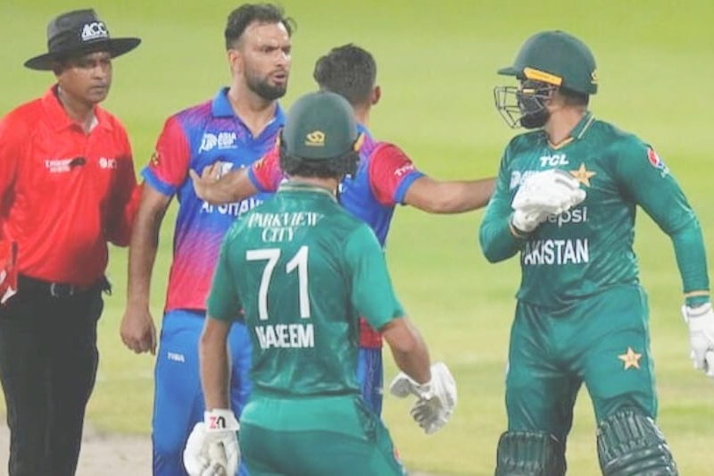
Event Inference
Event
Critical Match Events
We identify critical match events related to balls faced and runs scored by players, providing insight into key moments during matches.
Event data analysis helps in understanding the impact of specific actions or plays in a game.
Identifying key events is crucial for evaluating the performance and strategy of teams and players.

Slide 8
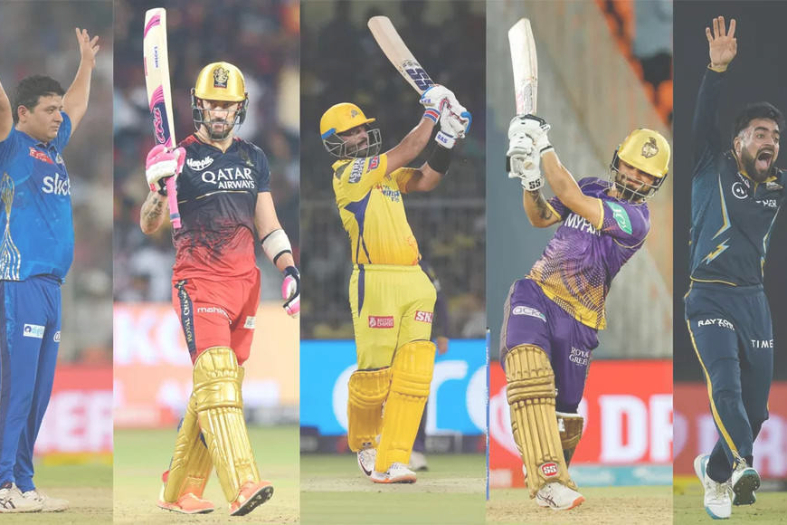
Performance Evaluation
Performance
Player Performance
Identifying top run-scorers in the T-20 World Cup 2022 dataset based on total runs scored.
Evaluating individual player performances to understand their contributions to the matches.
Using Python and Pandas to perform statistical analysis on player performance data.

Slide 9

Performance Evaluation Continued
Performance
Top Wicket-Takers
Identify the top wicket-takers in the T-20 World Cup 2022 dataset based on the total number of wickets taken.
Use the Pandas library to perform sorting and obtain a list of the top wicket-takers.
Evaluate the performance of these players in the context of their wicket-taking abilities.

Slide 10
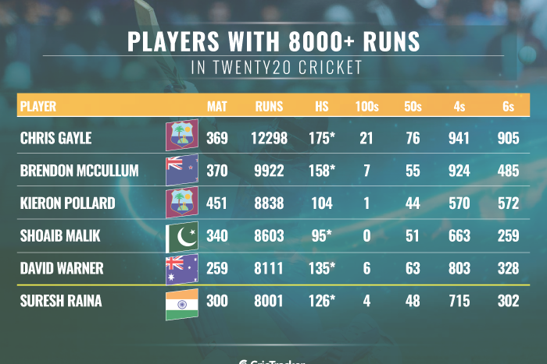
Statistical Insights
Statistics
Statistical Insights
Statistical insights such as the average runs scored per innings provide a comprehensive overview of scoring trends throughout the matches.
Average runs scored per innings can indicate the performance and consistency of teams or players in the tournament.
Understanding the average runs scored per innings is crucial for evaluating the overall scoring trend in T-20 World Cup 2022.

Slide 11
Thank you.

